Slide 1

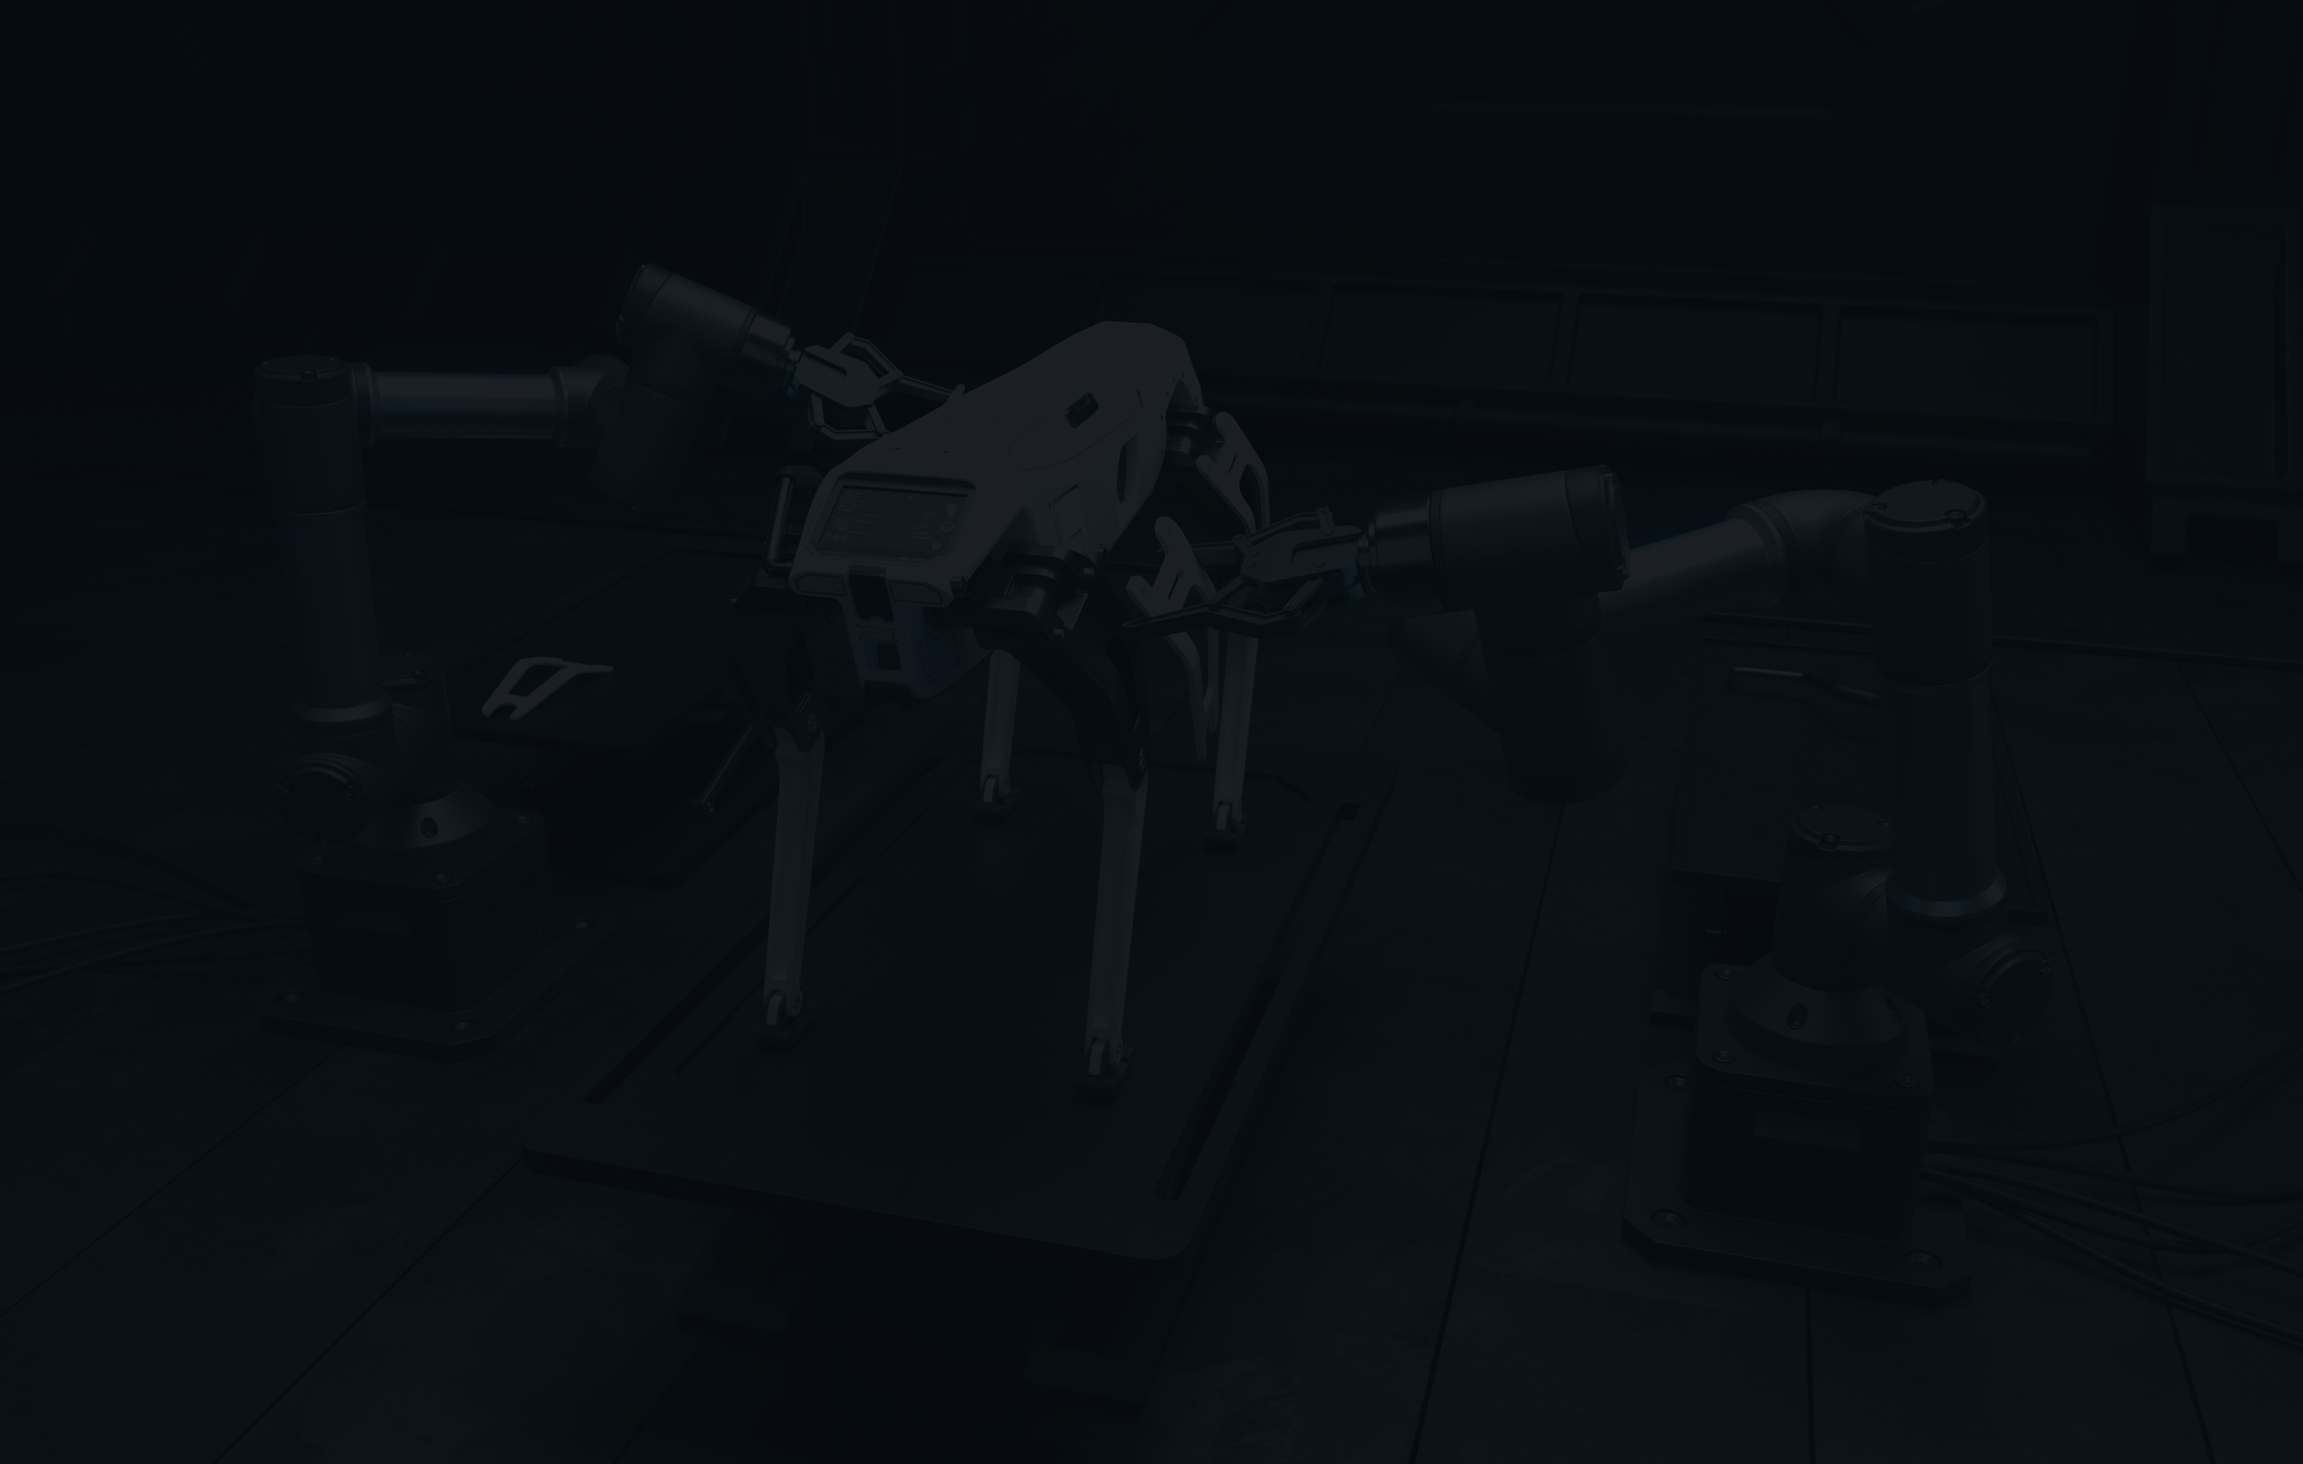


LINKEDIN JOB MARKETING ANALYSIS
team : Ashrutha
Krishnapriya
Meghana
next

Slide 2
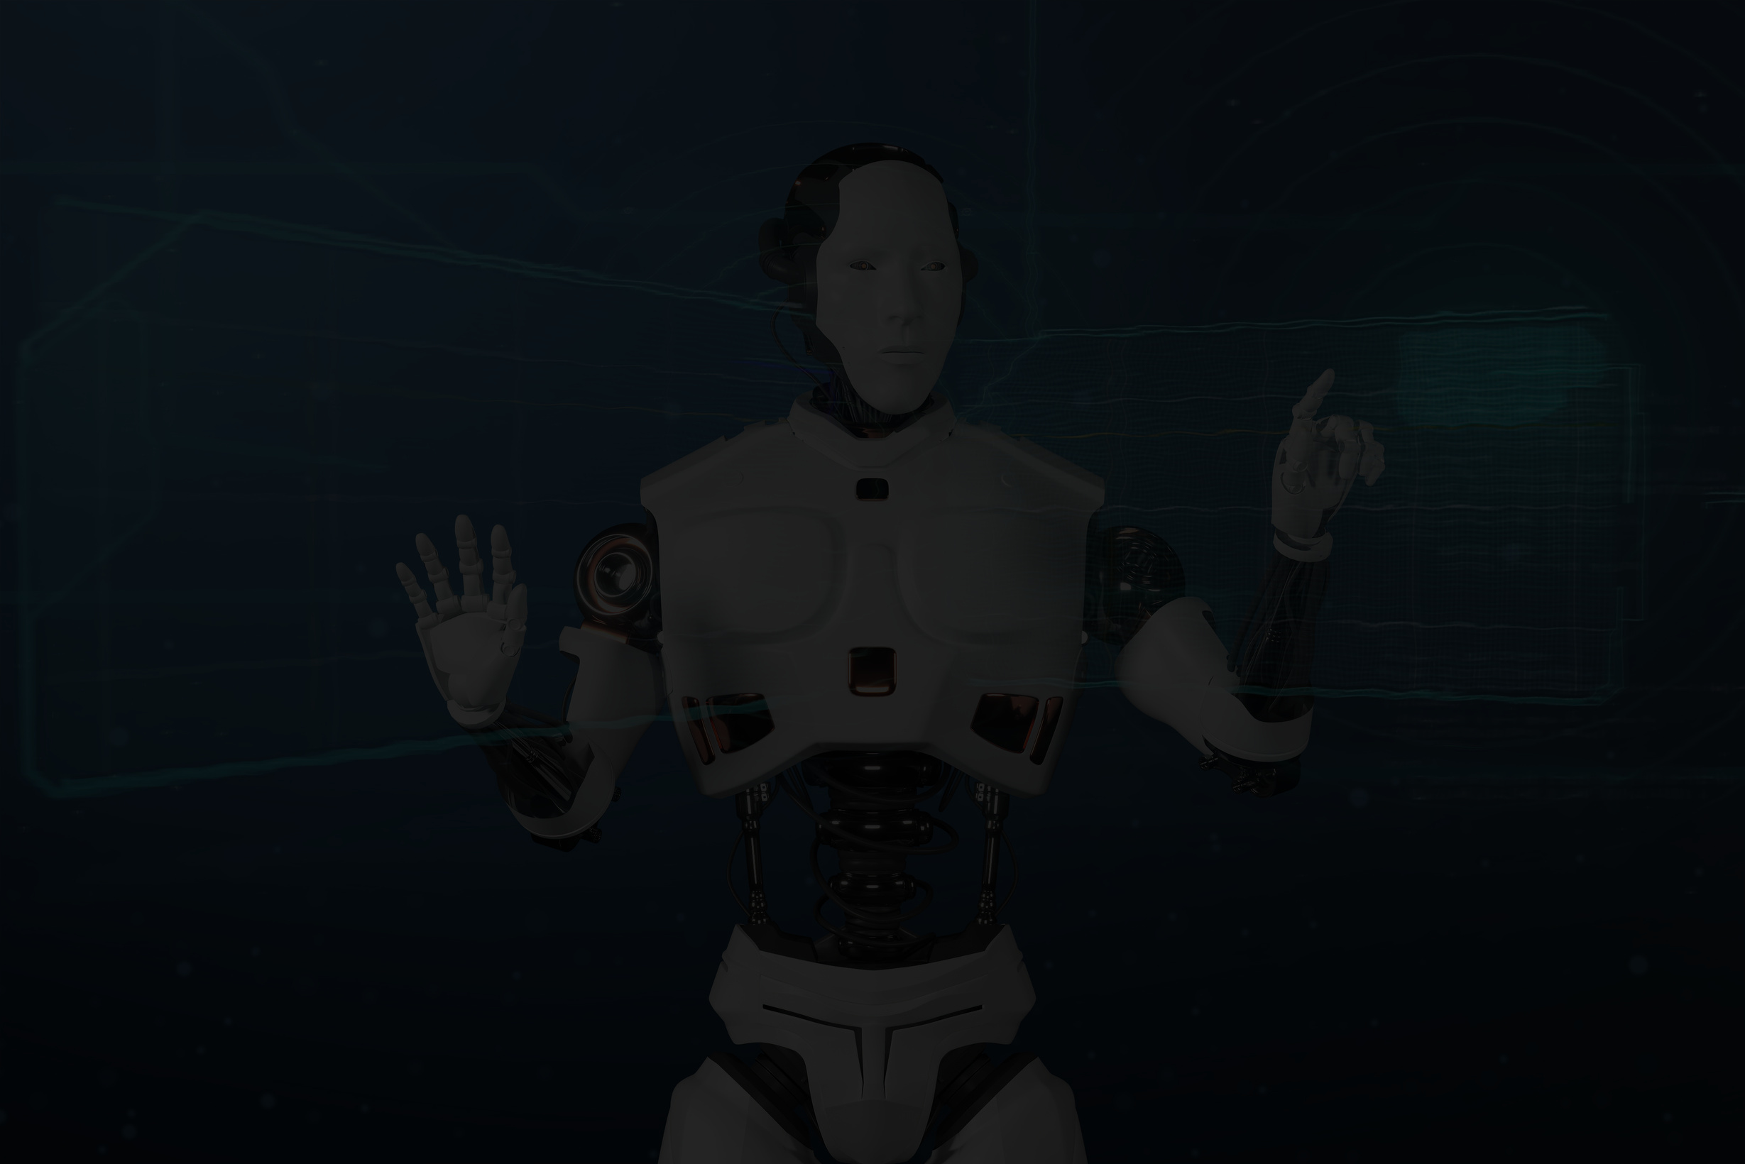

02
PROJECT OVERVIEW
This project aims to analyze the LinkedIn job market using a graph-based Artificial Intelligence approach to uncover hidden patterns and provide actionable insights into career trends, skill demand, and company hiring behaviors. By constructing a graph where nodes represent skills, job titles, and companies, and edges denote their relationships and co-occurrences, the system enables a deeper understanding of the job ecosystem. Graph Neural Networks (GNNs) and data analysis techniques are used to perform tasks like skill clustering, role prediction, and correlation analysis. The data is visualized through an interactive dashboard built using Streamlit, which allows users to upload datasets, explore top roles, skill demands, and company-level hiring trends.
next

Slide 3

03
PROBLEM STATEMENT
Despite LinkedIn hosting vast amounts of job-related data, the information is often unstructured and hard to interpret. Job seekers struggle to find tailored pathways that align with market needs, while recruiters face difficulties identifying upcoming skills and roles. Traditional analytics tools fail to capture the complex many-to-many relationships among job roles, skills, and employers, which are better understood through graph-based representations
next

Slide 4


04
PROPOSED SOLUTION
This project delivers a graph-based, interactive job market analysis system that turns raw LinkedIn data into actionable insights. Users can upload custom datasets and explore trends via a Streamlit dashboard featuring visualizations of top companies, job roles, and locations. Advanced capabilities include correlation analysis, outlier detection, and skill demand breakdowns for key roles using data aggregation. With real-time interactivity and a visually enhanced UI, this solution empowers job seekers, recruiters, and analysts with data-driven decision support.
next

Slide 5
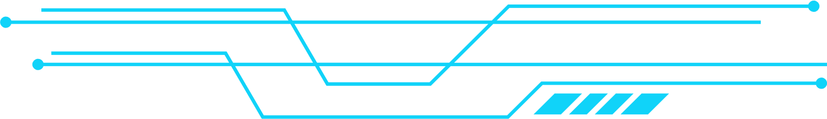

05
PROJECT APPROACH
Data Collection
Data Preprocessing
Exploratory Data Analysis (EDA)
Interactive Dashboard Development
Correlation Analysis
Skill Demand Insight
Outlier Detection
next

Slide 6

06
METHODOLOGY
DATA COLLECTION ->
PREPROCESSING ->
EDA ->
Dashboard->
Insights
next

Slide 7

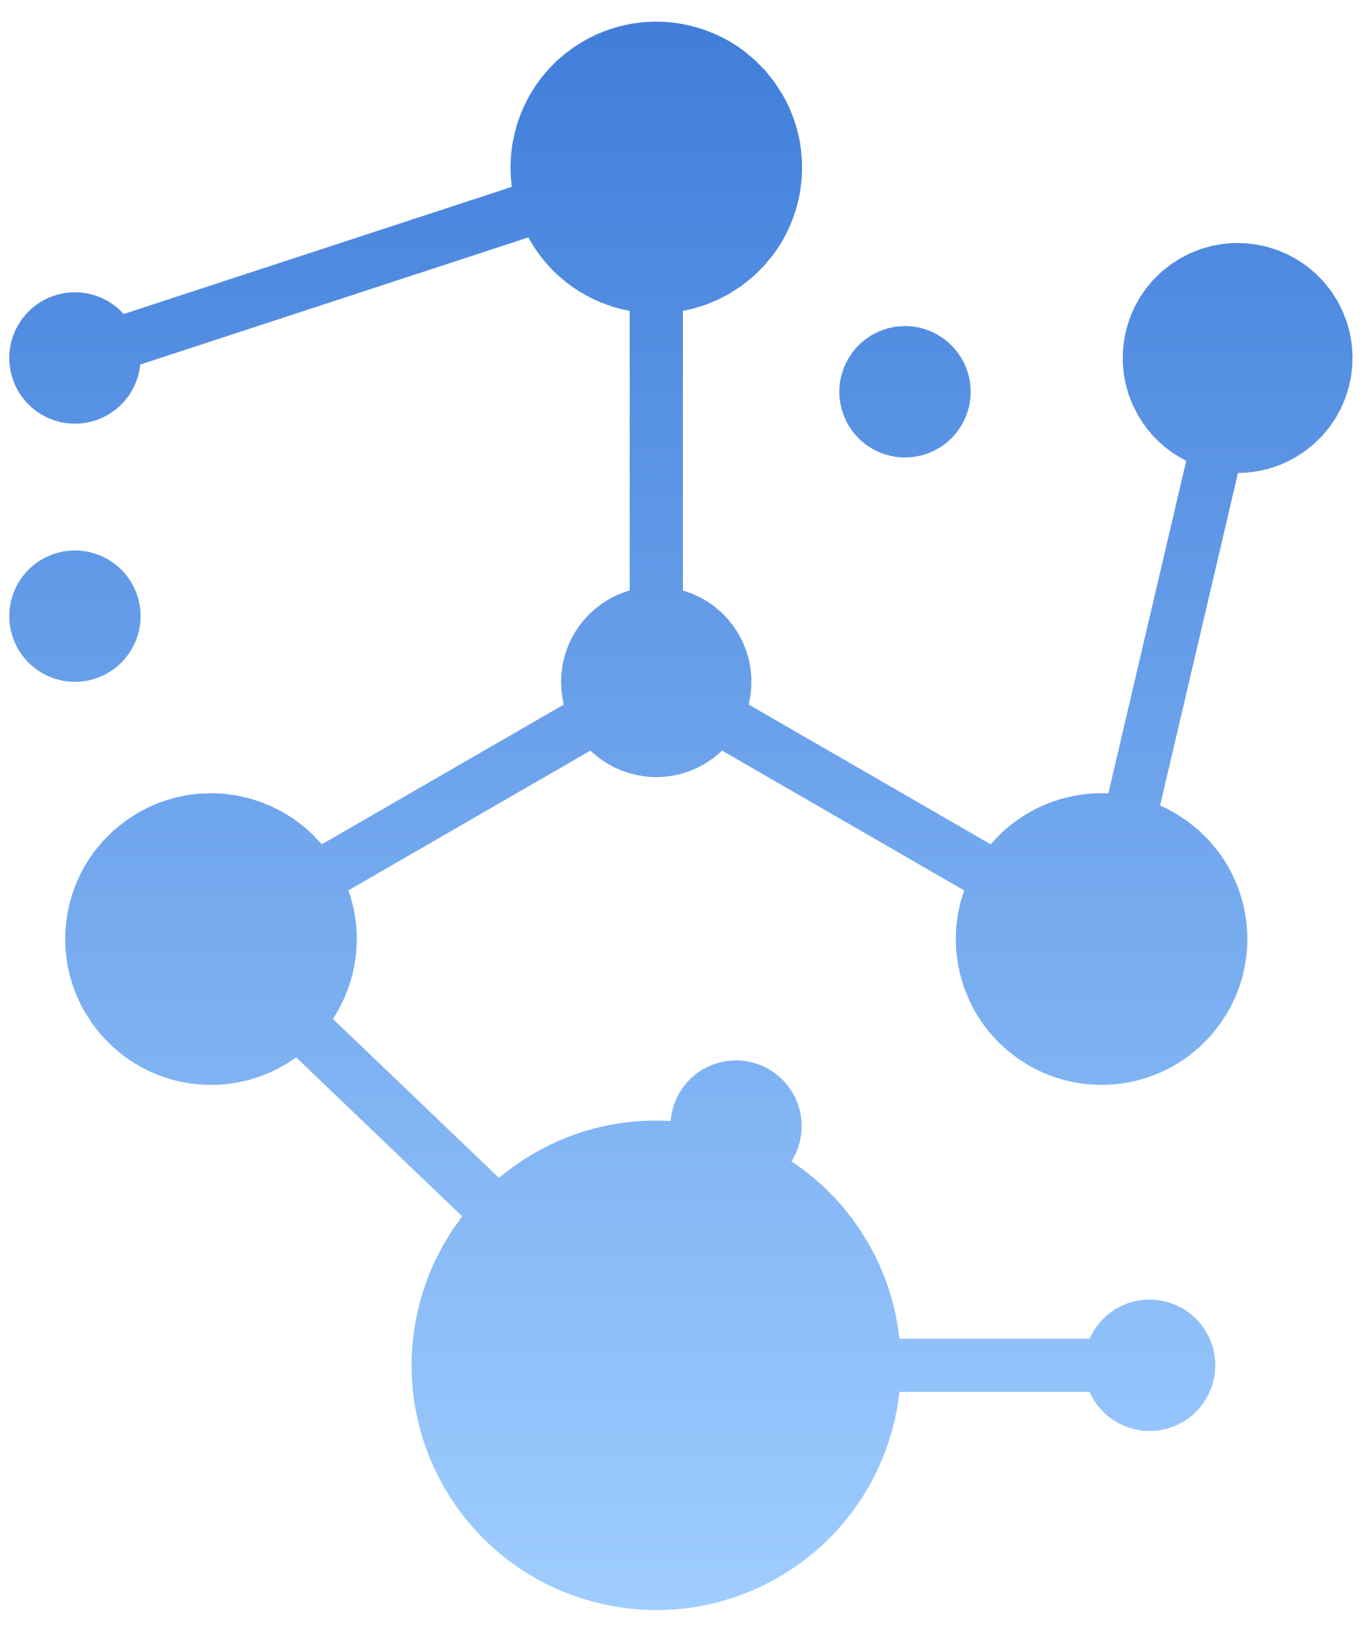
TECH STACK
07
🌐 Frontend:
Streamlit: Used to build the interactive web dashboard
HTML/CSS: For basic UI customization and styling
🖥️ Backend:
Python: Core programming language for all data processing and logic
Pandas: Used for data manipulation and preprocessing
Basic Correlation Analysis: For finding relationships between features like LinkedIn followers and applicants
Skill Demand Analysis: Using aggregation techniques to infer demand patterns
🤖 Machine Learning / AI:
🛠️ Tools & IDE:
VS Code: Development environment
Streamlit CLI: For local app deployment (streamlit run app.py)
next

Slide 8

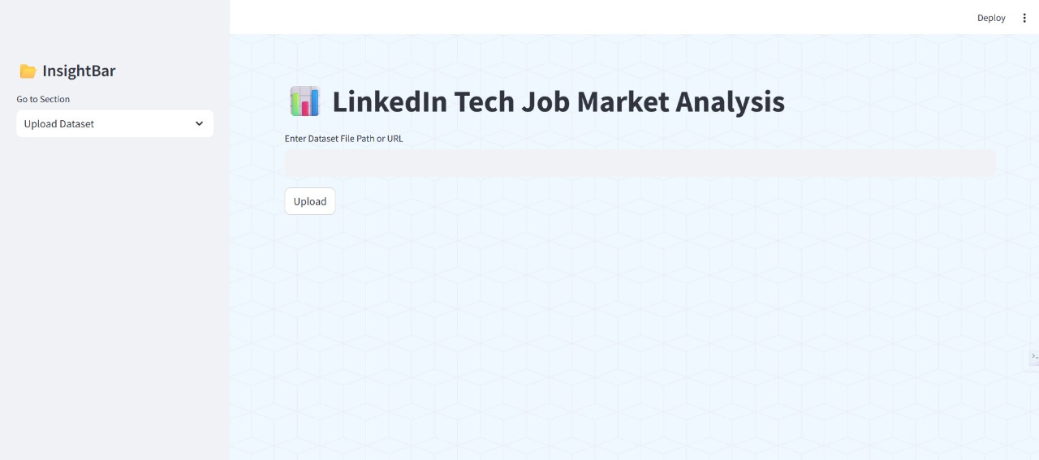
OUTPUTS
08
next

Slide 9
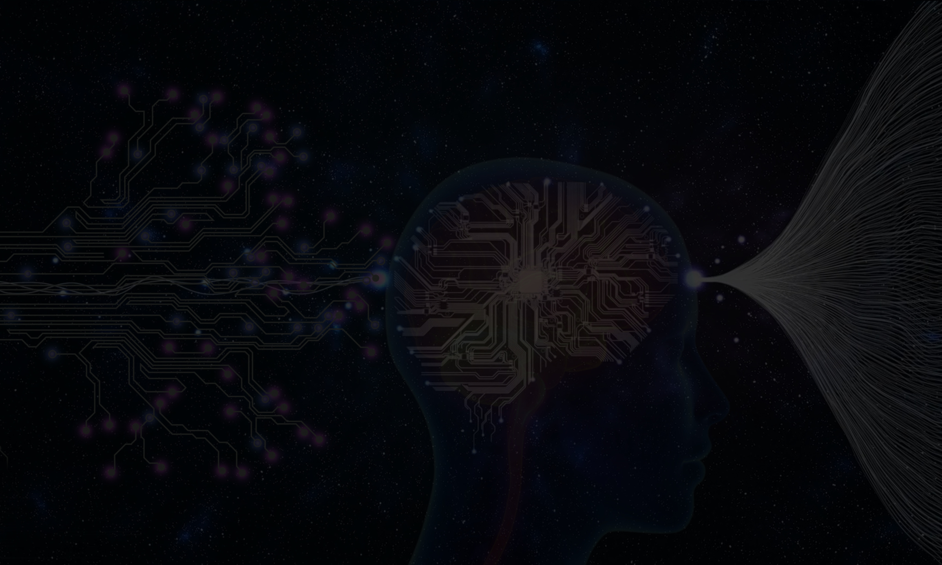
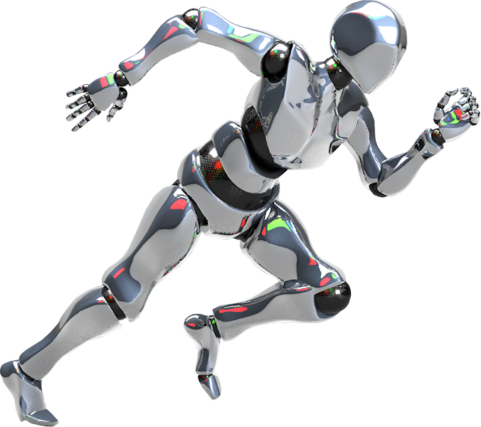
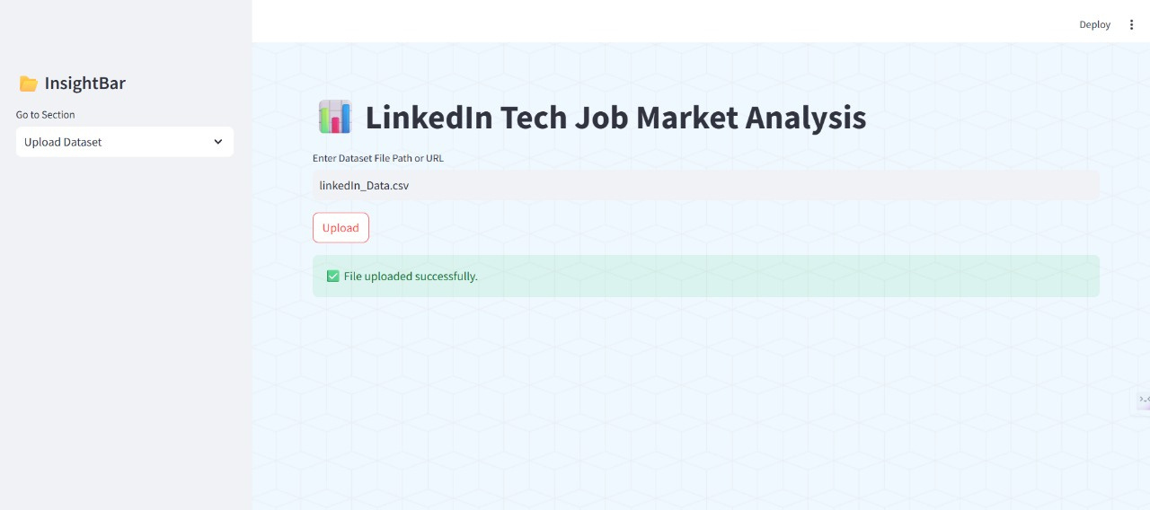
09
next

Slide 10
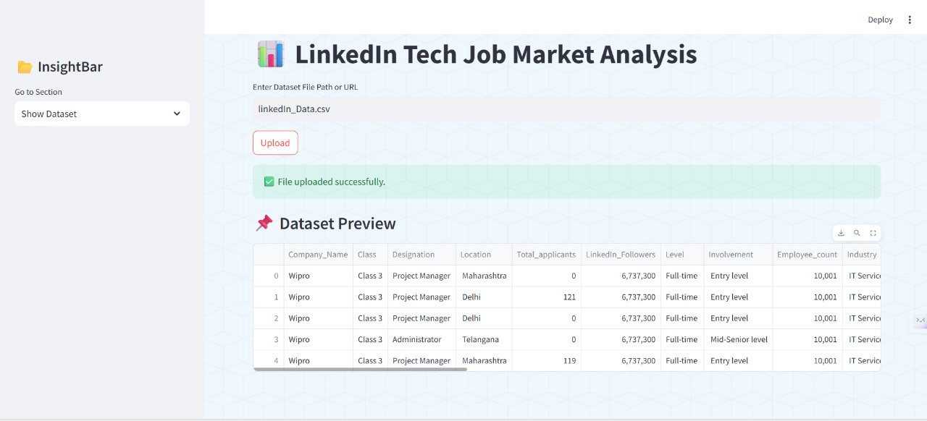

Slide 11
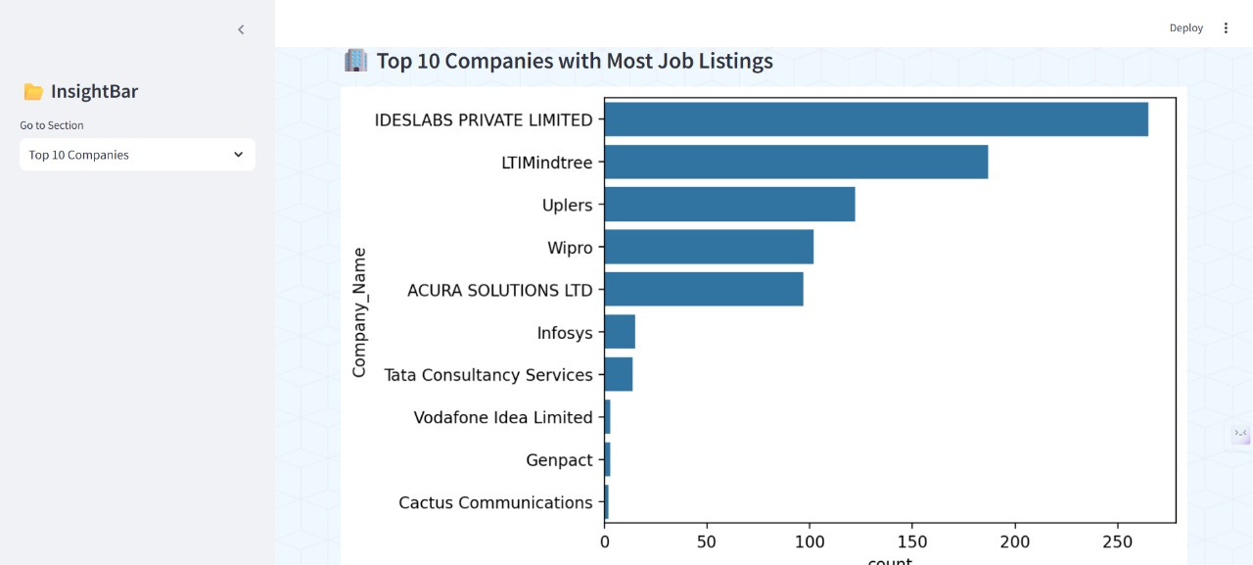

Slide 12
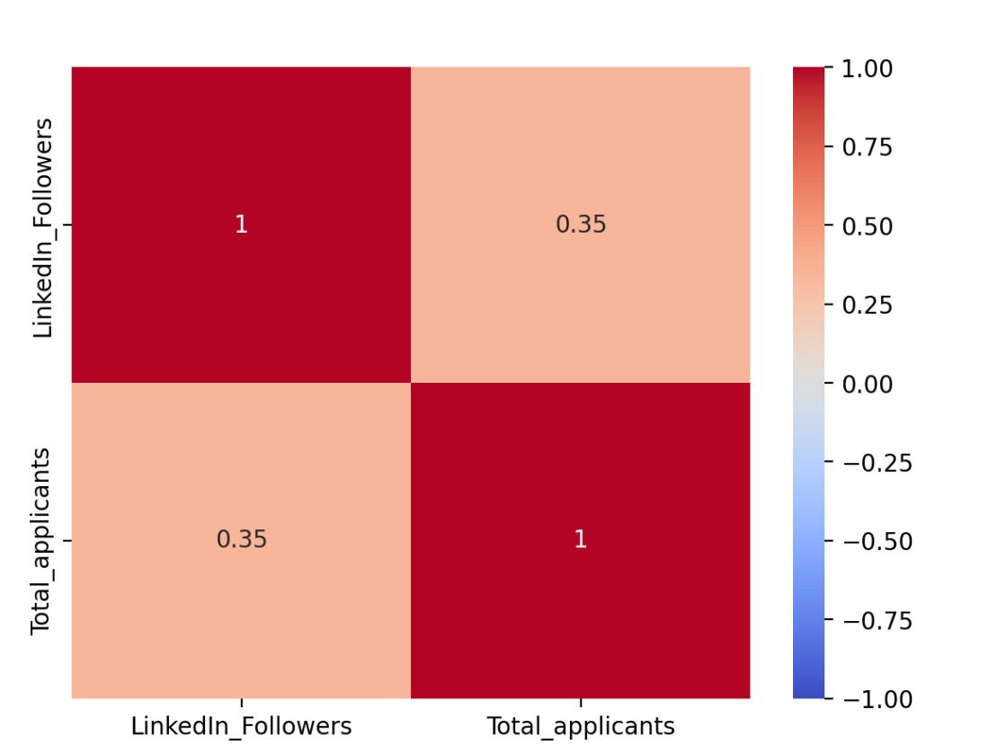

Slide 13
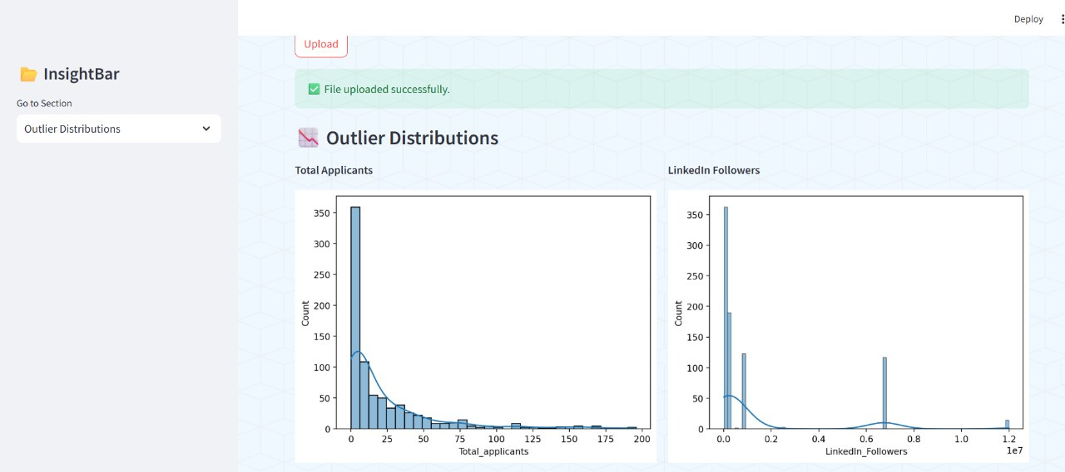

Slide 14

10
THANK YOU!

